Slide 1
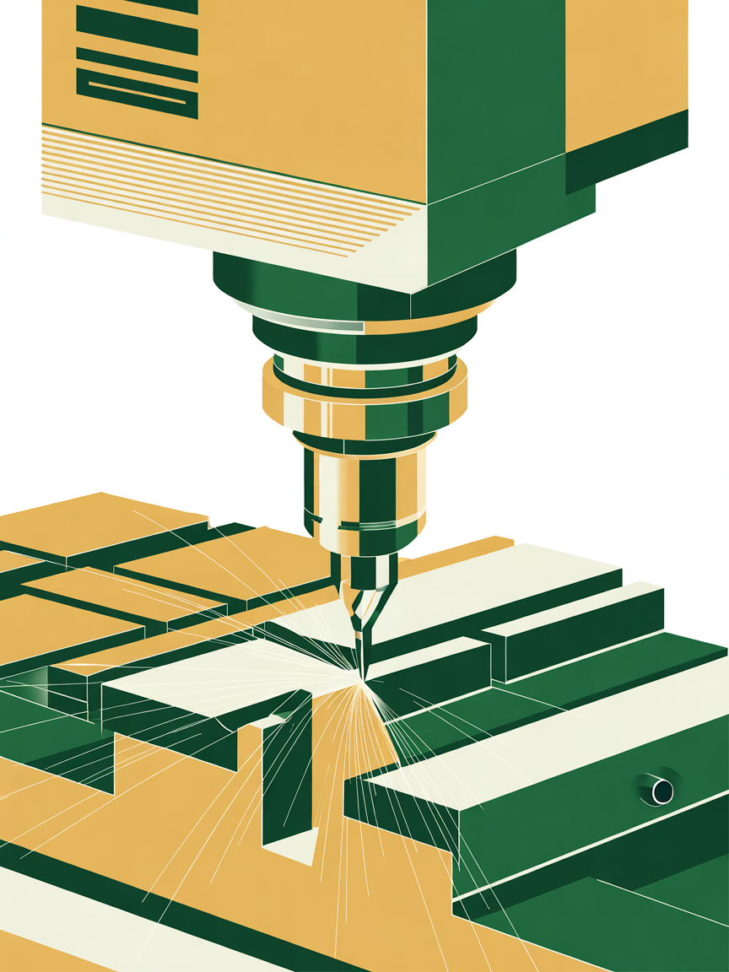
Predictive Maintenance of CNC Milling Machine
Tool Wear Estimation using Multi-Sensor Data
Team Members: Aneesha Deshmukh (221ME107)
Naisha Kishore (221ME333)
Minor Project, IT Dept NITK 2025-2026
Notes:
1

Slide 2
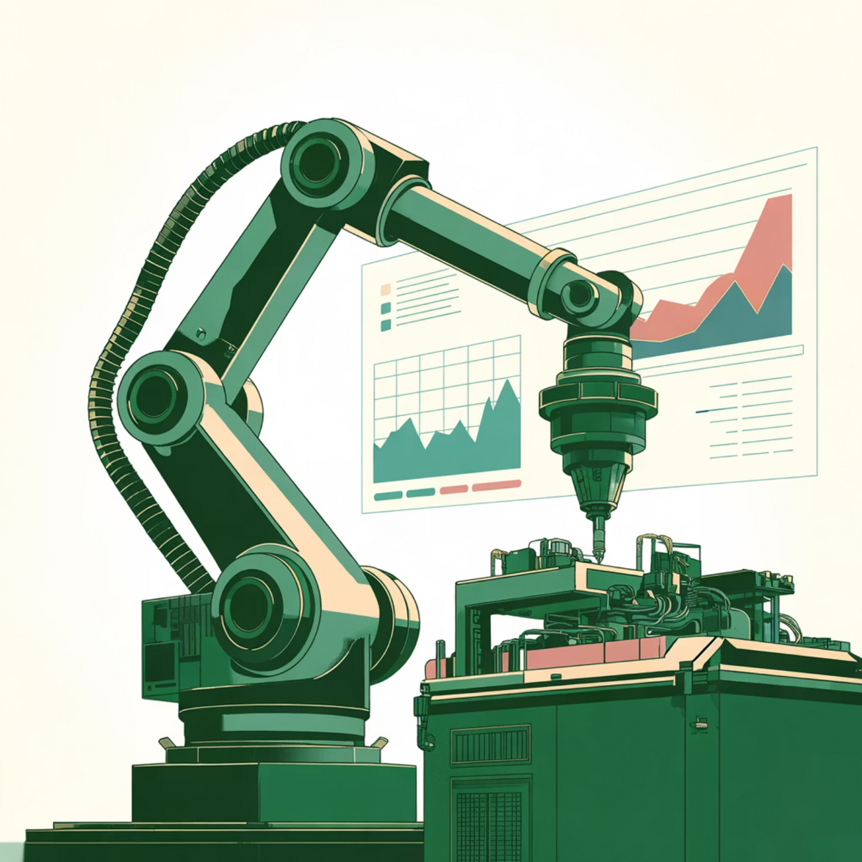
Introduction & Motivation
Why Predictive Maintenance?
Tool wear is critical in CNC milling, affecting product quality, efficiency, and machine downtime. Traditional monitoring is often inaccurate or inefficient.
The rise of Industry 4.0 and IoT sensing allows for continuous, precise monitoring using data analytics.
Problem Statement
Raw sensor signals are noisy and high-dimensional. The challenge is transforming multi-sensor data into meaningful features and building a stable regression model to estimate tool wear.
Notes:
3

Slide 3



Project Objectives
Exploratory Data Analysis (EDA)
Feature Engineering
Model Development
Preprocess and extract informative statistical, temporal, and spectral features from force, vibration, and acoustic emission signals.
Develop and evaluate a baseline regression model (regularized linear regression) to estimate tool wear from the engineered features.
Identify trends, correlations, and wear-related signal patterns in the machining sensor dataset.
Notes:
4

Slide 4
Literature Survey
Title | Author | Work done | Limitations
Tool wear prediction based on multisensor data fusion and machine learning | Jones, T. & Cao, Y. (2025) | Collected force, vibration, AE data from CNC milling; extracted 28 statistical features; used three-level data fusion (raw, feature, decision); trained RF, XGBoost; best result with (RF+XGBoost) achieving RMSE ≈ 58 µm. | Requires manual feature engineering; not fully end-to-end; ensemble is computationally heavier for deployment in real-time.
Deep learning-based tool wear prediction using multi-scale feature fusion | Xu, X. et al. (2022) | Proposed multi-scale CNN with channel attention mechanism for learning features from multi-sensor signals; improved accuracy by capturing tool wear patterns at multiple scales. | Increased network complexity; computationally more expensive for real-time use.
Tool Wear Prediction Based on Multi-Scale CNN with Attention Fusion | Huang, Q. et al. (2021) | Developed multi-scale CNN with attention-based feature fusion for tool wear regression; showed that combining multi-resolution feature maps improves prediction robustness. | Performance sensitive to kernel size choices; may overfit on small datasets without regularization.
Survey: Deep Learning Models for Predictive Maintenance | Serradilla / Zugasti et al. (2020) | Reviewed CNN, RNN, Autoencoder, VAE-based approaches for predictive maintenance tasks, highlighting benefits of multimodal fusion and hybrid models. | Mostly descriptive; no experimental results; does not give direct implementation details.

Slide 5
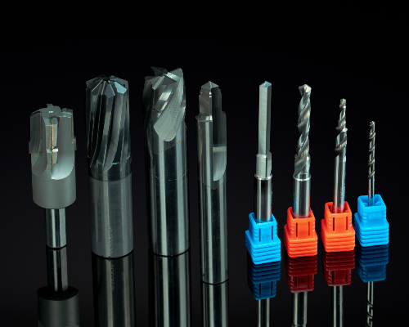




Methodology: Data to Prediction
Data Collection
Multimodal measurements (force, vibration, AE) from CNC machine. Tool wear values used as the target variable.
EDA & Understanding
Computed summary statistics, visualized temporal trends, and performed correlation analysis to identify wear-sensitive channels.
Feature Engineering
Extracted time-domain, frequency-domain, and acoustic emission features to convert raw signals into meaningful descriptors.
Model Development
Lasso Regression used for prediction. Evaluated performance using MAE/RMSE and analyzed coefficients for interpretability.
Notes:
5

Slide 6



Feature Engineering Categories
Three categories of features were extracted to capture statistical behavior, frequency composition, and acoustic characteristics related to tool wear.
Time-Domain Statistical
Frequency-Domain
Acoustic Emission (AE)
Metrics like mean, RMS, standard deviation, skewness, and kurtosis summarize signal energy and shape over time.
Quantify energy distribution using FFT (e.g., dominant frequency, spectral centroid). Captures high-frequency components from chatter.
Captures transient events like micro-fractures and cutting instabilities. Features include burst count, RMS, and AE energy.
Notes:
6

Slide 7
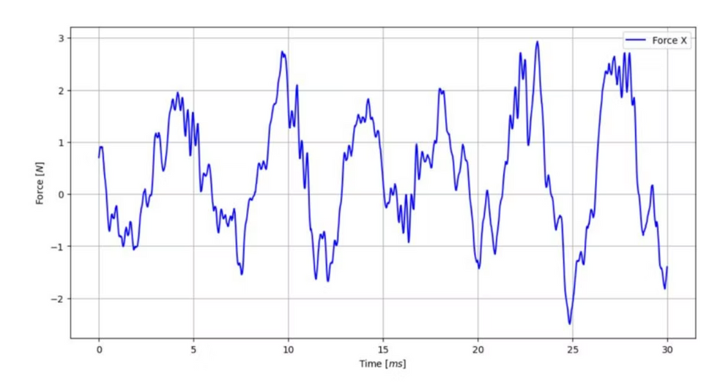
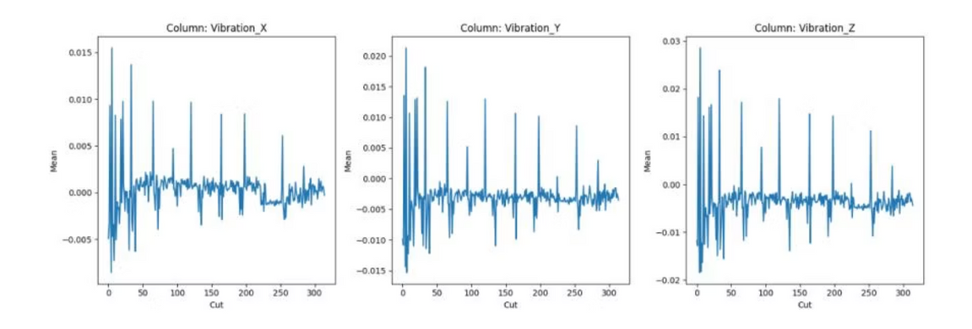
Results: Sensor Signal Behavior
EDA confirmed that sensor channels carry measurable signatures of wear progression.
Force Signals
Vibration & AE Signals
Exhibited increasing mean and peak values as the tool deteriorated, indicating greater cutting resistance.
Vibration showed higher variability and pronounced spikes (increased chatter).
Acoustic Emission displayed more frequent burst events and elevated high-frequency activity (micro-fractures).
Notes:
7

Slide 8
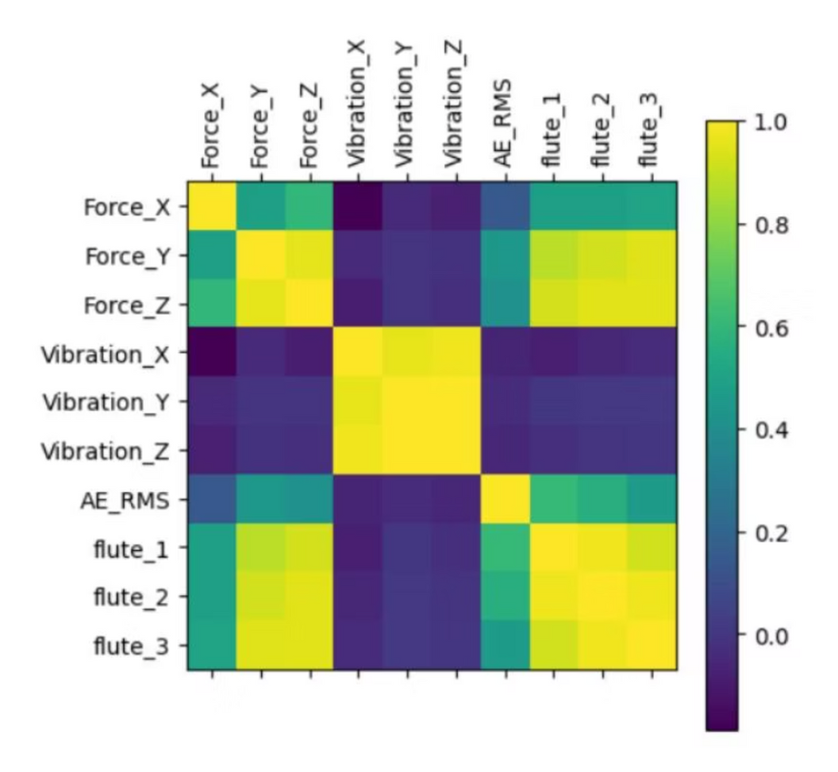

Feature Performance and Correlation
The engineered features provided a stable representation of wear-related variations, with strong correlations identified between key features and tool degradation.
Time-Domain
RMS, standard deviation, and peak-to-peak amplitude increased consistently with wear.
Frequency-Domain
Spectral centroid and band-power captured the energy shift toward higher frequencies.
Strongest Indicators
RMS force, vibration variance, spectral centroid, and AE energy were validated as strong indicators of tool condition.
Notes:
7

Slide 9
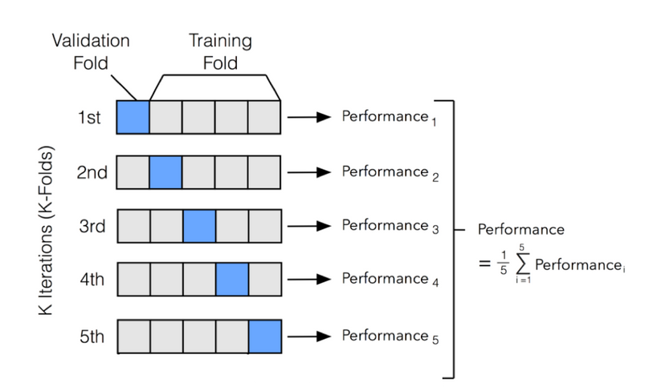
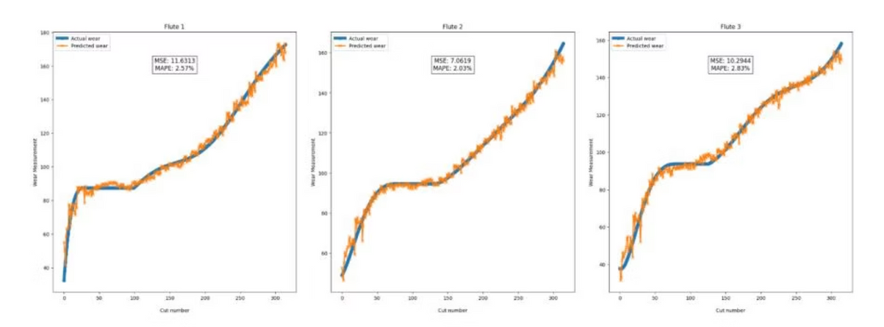
Model Performance: Lasso Regression Baseline
Lasso regression provided an interpretable and stable baseline for tool wear estimation, effectively capturing the dominant wear-related behavior.
1
Stable Prediction
Predicted wear values followed the general trend of the measured data, confirming the model's capability.
2
Regularization Benefit
Lasso effectively removed redundant features, improving generalization and demonstrating a strong baseline.
3
Key Features Identified
Lasso coefficients highlighted force RMS, vibration variance, spectral centroid, and AE energy as the most influential features.
Notes:
8

Slide 10
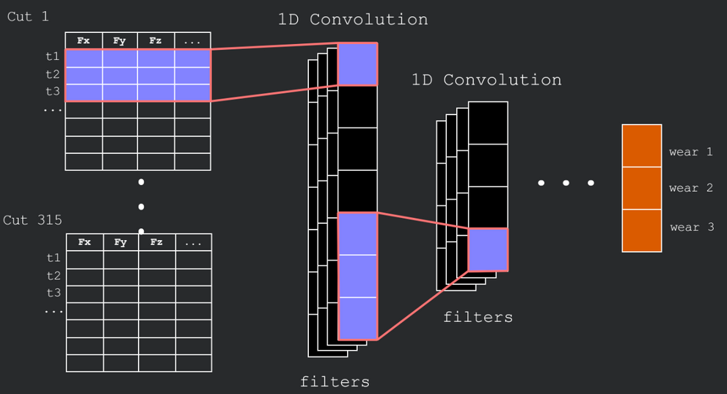
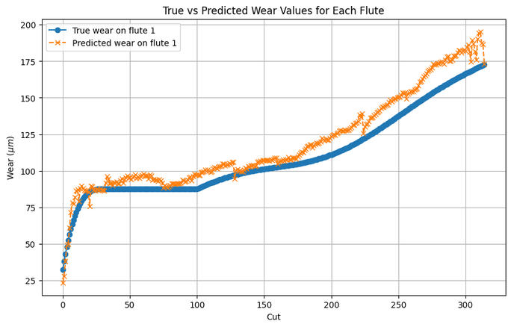
Model Performance: CNN
A 1D convolutional neural network learned temporal representations from multi-channel spindle signals to predict flute wear, producing robust predictions and exporting results for dashboarding.
1
Stable Prediction
Predicted wear curves followed the main trend of measured wear across cuts, confirming the model captures the dominant temporal wear pattern.
2
Representation Learning Benefit
The CNN automatically learned hierarchical temporal features from raw signals (no manual feature engineering), improving predictive power compared to simpler baselines.
3
Temporal & Multi‑channel Learning
The 1D convolutions and pooling capture short- and medium-term patterns across channels (force, vibration, AE). Adaptive pooling produces compact per-cut predictions for each flute.
Notes:
8

Slide 11
Conclusion
Framework Success
Successfully developed a baseline data-driven framework for tool wear estimation using multi-sensor machining data.
Feature Validation
Engineered features provided informative representations of signal changes, proving more reliable than raw measurements alone.
Interpretability
Lasso regression and CNN confirmed that influential features (Force RMS, AE Energy) align with physical machining phenomena (cutting resistance, micro-fracture activity).
Notes:
9

Slide 12

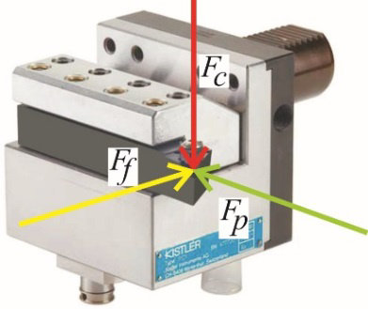



Future Work & Expansion
Advanced ML Models
Explore ensemble methods to capture nonlinear relationships for improved accuracy.
Real-Time Monitoring
Implement streaming data pipelines and sliding-window feature extraction to support online prediction during machining.
Model Generalization
Expand the dataset to include different tool types, materials, and cutting conditions.
Signal Processing Techniques
Evaluate additional techniques like wavelet features or envelope analysis for more sensitive wear indicators.
Notes:
10

Slide 13
References
[1] Jones, Tanner, and Yang Cao. "Tool wear prediction based on multisensor data fusion and machine learning." The International Journal of Advanced Manufacturing Technology (2025): 1-13.
[2] Xu, Xingwei, et al. "Deep learning-based tool wear prediction and its application for machining process using multi-scale feature fusion and channel attention mechanism." Measurement 177 (2021): 109254.
[3] Huang, Qingqing, et al. "Tool wear prediction based on a multi-scale convolutional neural network with attention fusion." Information 13.10 (2022): 504.
[4] Serradilla, Oscar, et al. "Deep learning models for predictive maintenance: a survey, comparison, challenges and prospects." Applied Intelligence 52.10 (2022): 10934-10964.
[5] Khan, Uzair, et al. "A Comprehensive Survey on Deep Learning-based Predictive Maintenance." ACM Transactions on Embedded Computing Systems (2025).
[6] Duan, Jian, et al. "MS-SSPCANet: A powerful deep learning framework for tool wear prediction." Robotics and Computer-Integrated Manufacturing 78 (2022): 102391.
[7] Liu, Xianli, et al. "An approach for tool wear prediction using customized DenseNet and GRU integrated model based on multi-sensor feature fusion." Journal of Intelligent Manufacturing 34.2 (2023): 885-902.

